Slide 1
Predicting Basketball Ticket Prices
Darin Materman & Abigail Snyder 5.15.2024

Slide 2
Project Overview
Executive Summary
Exploratory Data Analysis
Methodology
Additional Scraping
Feature Selection
Model Performance and Results
Next Steps

Slide 3
Project Overview: Pricing NBA Arena Seats
Data Sources:
Secondary Market Ticket Sales
Focus Areas:
Supervised Machine Learning
Ticket Pricing
Presentation and Communication
Business Analytics
Project Overview
Given historical ticket prices, matchup info, and seat location: help an NBA team price single game tickets
Each NBA team has to price thousands of single game tickets for 41 home games and then update the price in real time to align with secondary market trends
How can we use seat quality characteristics and market data to assign the optimal ticket prices to unsold inventory?

Slide 4
Project Overview
Executive Summary
Exploratory Data Analysis
Methodology
Additional Scraping
Feature Selection
Model Performance and Results
Next Steps

Slide 5
Executive Summary
Ticket prices are highly dependent on x,y,z
Removing outliers and filtering key data…
Importance of additional variables; home and visitor win percentages

Slide 6
Project Overview
Executive Summary
Exploratory Data Analysis
Methodology
Additional Scraping
Feature Selection
Model Performance and Results
Next Steps

Slide 7
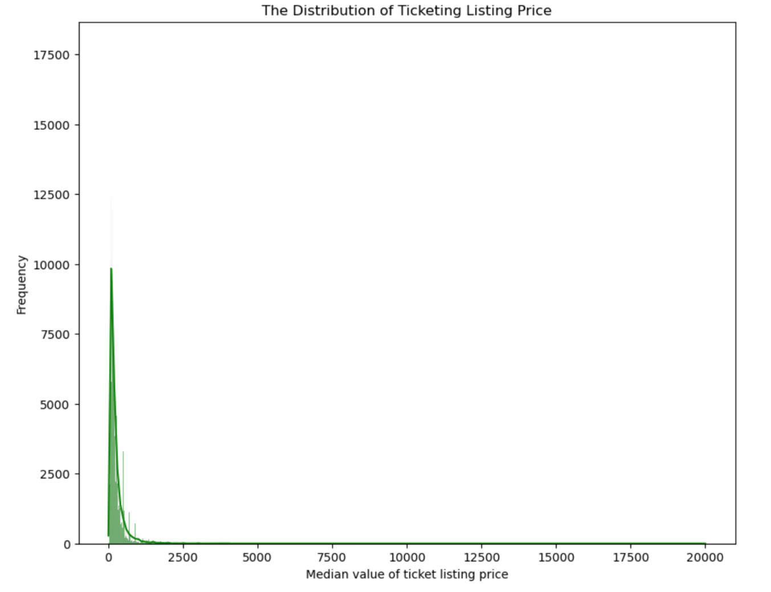
Exploration: Distribution of Ticketing Listing Price
We initially used exploratory data analysis to get a feel for the data, any missing values and outliers, and features.
The ‘Ticketing Listing Price’ feature had one notable outlier: a ticket valued at $20,000, as seen in the distribution plot here.
The question is whether this is a valid ticket price, or whether it is an error in data collection. Without knowing the answer to this, we chose to remove it from the model calculation, as it is a single ticket value which could skew the results.

Slide 8
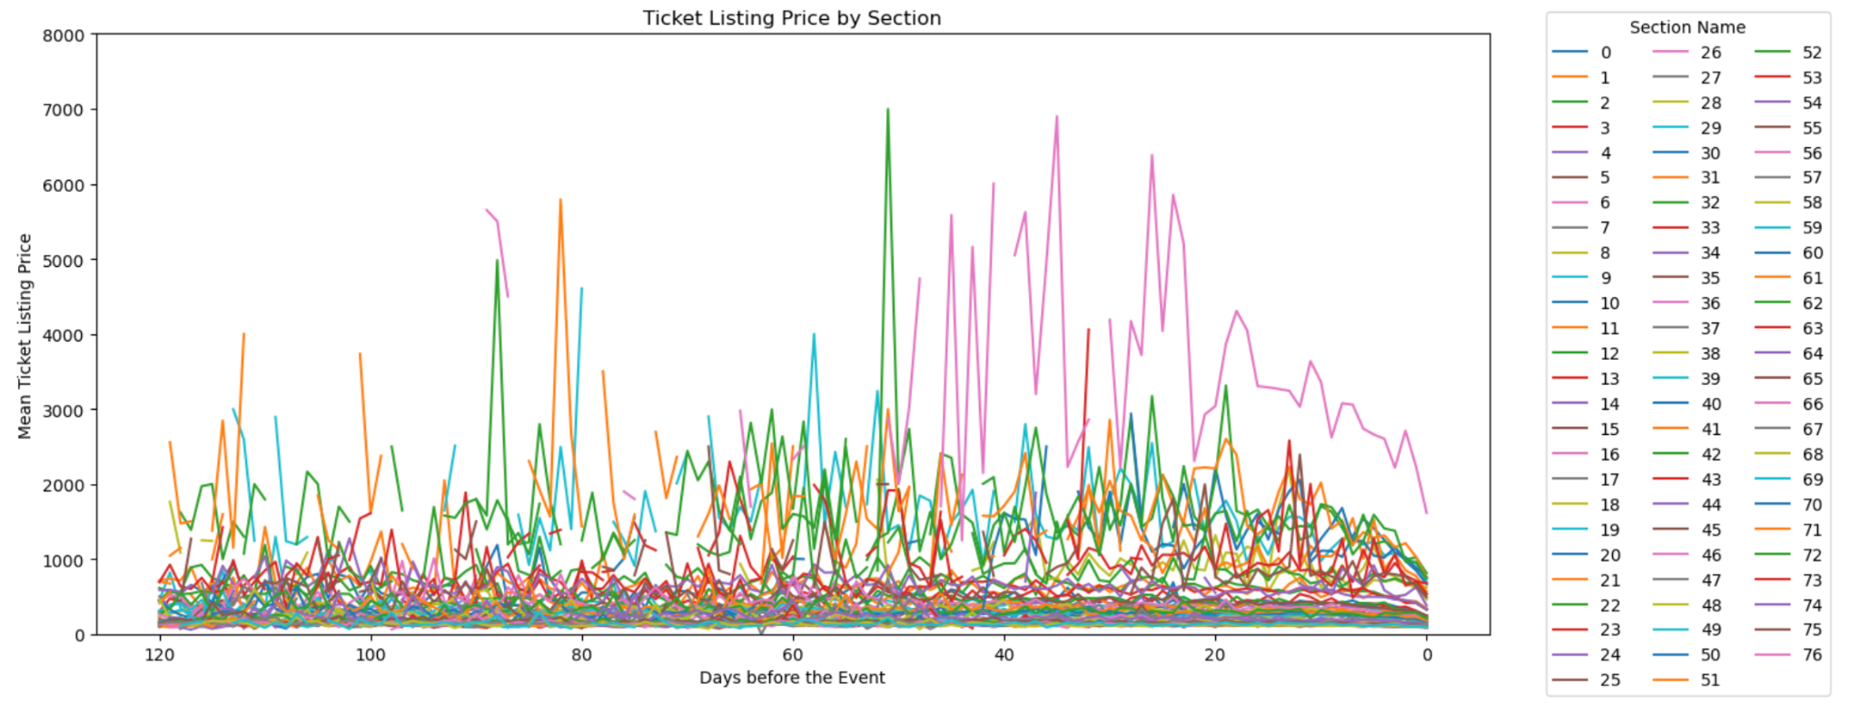
Exploration: Ticket Listing Price and Variance
Notably, some sections have a much higher variance in listing price than others.

Slide 9
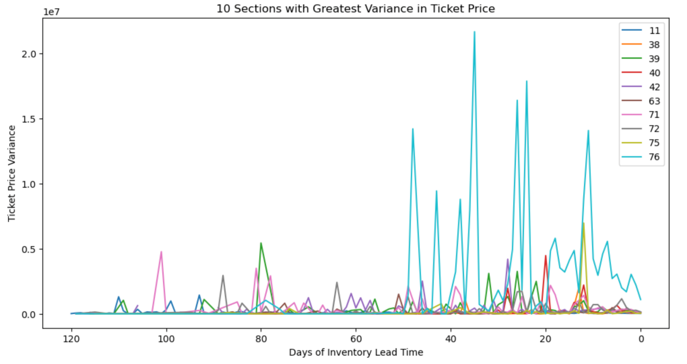
Exploration: Ticket Listing Price and Variance
Here, we plot the ten sections with the greatest variance in ticket price, noting again that most of that variance occurs in the final 45 days leading up to a game, validating the assumption that ticket price generally increases in the lead-up to an event.

Slide 10
Project Overview
Executive Summary
Exploratory Data Analysis
Methodology
Additional Scraping
Feature Selection
Model Performance and Results
Next Steps

Slide 11
Methodology:

Slide 12
Project Overview
Executive Summary
Exploratory Data Analysis
Methodology
Additional Scraping
Feature Selection
Model Performance and Results
Next Steps

Slide 13
Additional Scraping: Pulling In Home And Visitor Win Percentages

Slide 14
Project Overview
Executive Summary
Exploratory Data Analysis
Methodology
Additional Scraping
Feature Selection
Model Performance and Results
Next Steps

Slide 15
Feature Selection:

Slide 16
Project Overview
Executive Summary
Exploratory Data Analysis
Methodology
Additional Scraping
Feature Selection
Model Performance and Results
Next Steps

Slide 17
Model Performance And Results:

Slide 18
Project Overview
Executive Summary
Exploratory Data Analysis
Methodology
Additional Scraping
Feature Selection
Model Performance and Results
Next Steps

Slide 19
Next Steps: Model Improvement And Additional Data
The end seat pricing decision relies on the bigger question of volume vs. revenue: do you want to sell out (volume), or get max revenue?
Consumer Elasticity Information as well as local demographic data could help answer this question
Season tickets typically have a lower average ticket price than individually sold tickets
This data doesn’t seem to indicate which seats are held by season ticket holders.
Game ranking - with additional time, it could be beneficial to build a secondary model to value games based on team win percentages, schedule factors, etc. to predict game revenue, which could then be integrated with the seat quality / pricing model.

